Slide 1
Formula 1 Driver Analyser A Visual Analytics Project
Luca Sannino 1542194

Slide 2
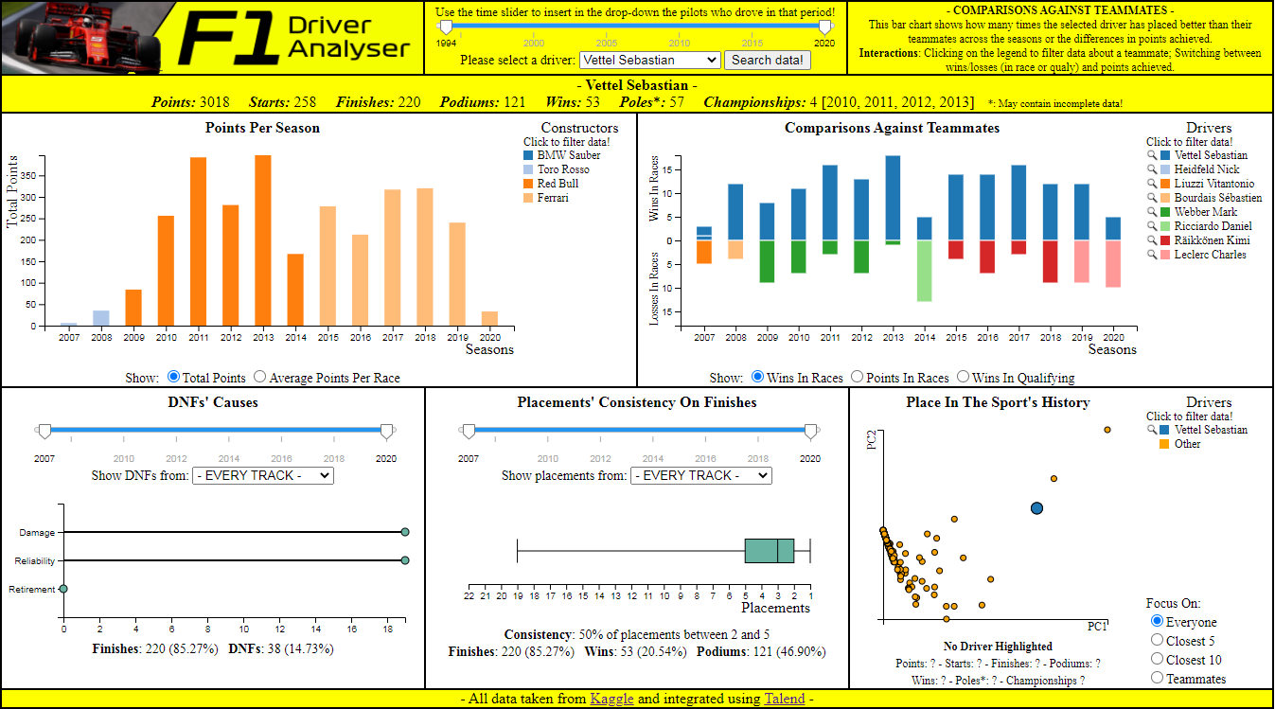
Brief Overview
“Driver Analyser” is a Javascript application that uses the D3.js library to create an interactive visual environment that displays stats about the career of a user-selected Formula 1 driver.

Slide 3
Target User
The target user is someone interested in having a greater understanding of a driver’s performance.
It can be someone internally in the teams themselves who is looking for the next best hire.
Or it can be just a passionate fan, the type that spends hours discussing which driver is better and why.
Or it can be just someone who likes to bet and win (hopefully) some easy money.

Slide 4
Target User
What may a user be interested in? Let’s try to guess it with a list!
● Is the driver on an upward trajectory, or are his best days clearly behind him?
● How does his performance compare against the ones of his teammates across his career?
● Does he gets DNF’d often? If so, it’s because he is a hothead who constantly gets involved in crashes/collisions, or it’s due to unlucky reliability issues?
● How constant he is in his placements? In which constructor did he gain the better results? In which circuits?
● How does he fit in the history of the sport itself, in terms of achievements reached?

Slide 5
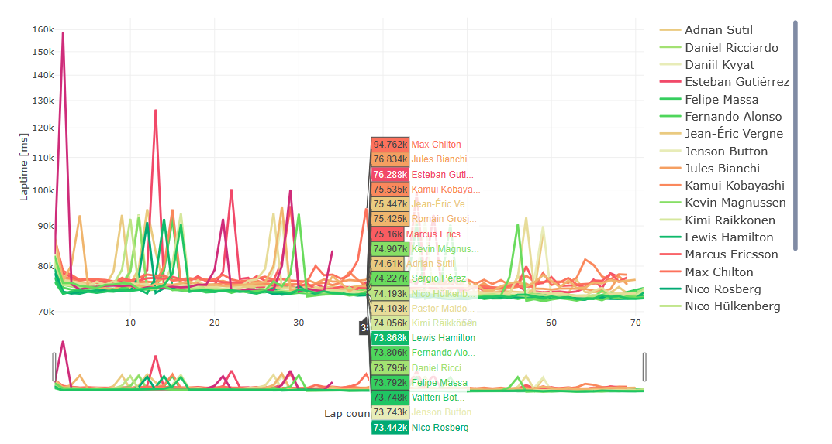
Related Works
Is there already another work that can help or be taken as inspiration? Sort of!
This is “Visual Analysis of F1 races” by Lampprecht et al.

Slide 6
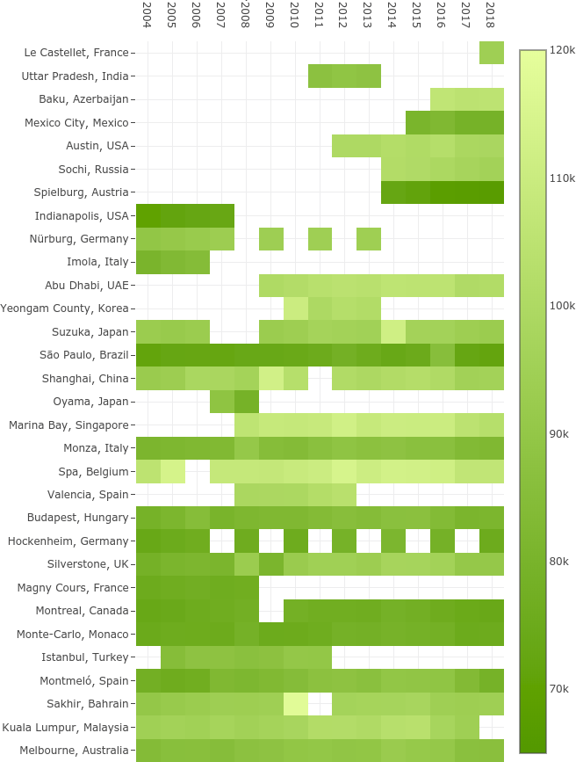
Related Works
Even though the work of Lampprecht et al. is still finalized to the study of a driver’s performance, there is one key difference.
That environment is “race-focused”, meaning that a user can learn about the drivers’ performances in relation to a given selected race, where they have the possibility to inspect their times down to single laps in a timeline graph.

Slide 7
Related Works
This work is, instead, meant to offer a “driver-focused” prospective, meaning that users get to choose drivers in order to gain a better knowledge about their performances across the entire stretch of their careers, and not for a race in particular.
The work proposed here is then meant as companion piece, since both tools together can now allow analyses that can be both focused on more narrower details, or that can look at the bigger picture.

Slide 8
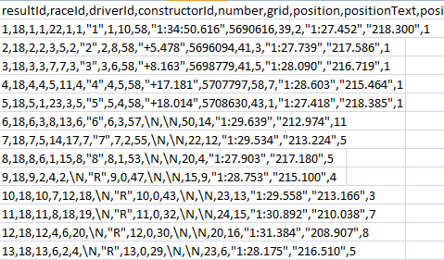
The Source Dataset
Thankfully a .csv dataset that contains stats about the entire history of Formula 1 is easy to find on Kaggle, courtesy of user Rohan Rao. The problem, though?
The dataset needs to be integrated before it is usable!

Slide 9
The Source Dataset
In ordert to integrate it, first I created the GAV mappings, which are new global schemas that act as views over the source ones. Here’s an example:
Source Schemas
results(…, raceId, driverId, constructorId, …, position, …, points, …, statusId) races(raceId, year, round, circuitId, name, ..) circuits(circuitId, …, name, …) driver(driverId, …, forename, surname, …) constructors(constructordId, …, name, …) status(statusId, status)
Global Schema
results(year, round, grandprix, circuit, surname, name, constructor, position, points, status)
GAV Mapping
{ (a, b, c, d, e, f, g, h, i, l) |
results(…, x1, x2, x3, …, h, .., I, …, x4), races(x1, a, b, x5, c, …), circuits(x5, …, d),
driver(x2, …, e, f, …),
constructors(x3, .., g, …),
status(x4, l)
} => results(a, b, c, d, e, f, g, h, i, l)

Slide 10
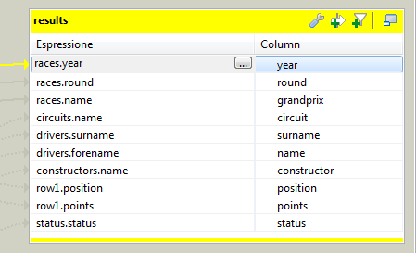
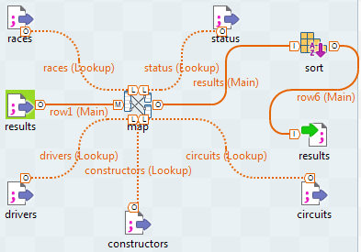
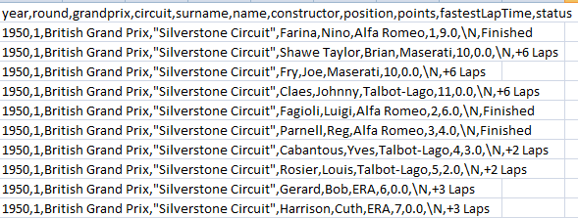
The Source Dataset
Then I used Talend Open Studio to apply those GAV mappings and finally obtain a ‘friendlier’ and focused version of the starting dataset.

Slide 11
Visualizations
The visualizations focus on the aspects of a driver’s career that are of particular interest, like points achieved, results against their teammates, DNFs and consistency of their placements.
In short they are meant to answer the questions asked in that list discussed previously.
Such visualizations include bar graphs, lollipop charts, box plots and scatter plots on multidimensional data achieved through PCA.
They also are interactive and synchronized between each other.

Slide 12
Points Per Season
This is a bar graph where every bar represents the points achieved by the driver across each year of his career.
The bars are also colored, so that the user knows the constructors they are associated with thanks to a legend that is near the graph.
If a pilot has driven for more constructors in the same year, then the bars are stacked on top of each other.

Slide 13
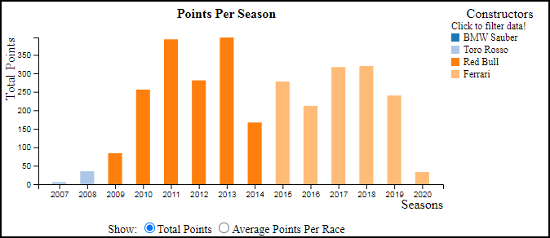
Points Per Season
Users can highlight bars by hovering the mouse on them or the legend
User can filter off constructors by using the legend
Users can switch between two units of measures
Users can calculate new means by clicking on the bars

Slide 14
Points Per Season
I think this visualization is useful because it gives a quick overview of where the driver was at the peak of his career, and where at the bottom.
In this way, by interacting with the legend, the user can entirely focus only on those stretches of time under particular constructors that caught their eye, filtering out from this chart and all of the others information that may be considered useless or superfluous at the task at hand.

